Slide 1
Acquiring Data
Notes:
Today we’re looking at the types of data that are hiding online, and how to bring them out of hiding and into your data science code.

Slide 2
Data Sources
data warehouses and catalogues
open government data
NGO websites
web searches
online documents, images, maps etc
people you know who might have data
Notes:
And here are some places to find them - there’s a longer list in the references folder.

Slide 3

Creating your own data: People
Notes:
Development data isn’t always easy to obtain: you might have to create your own, by asking people to contribute information to you through crowdsourcing, in-person surveys, mobile surveys etc.

Slide 4
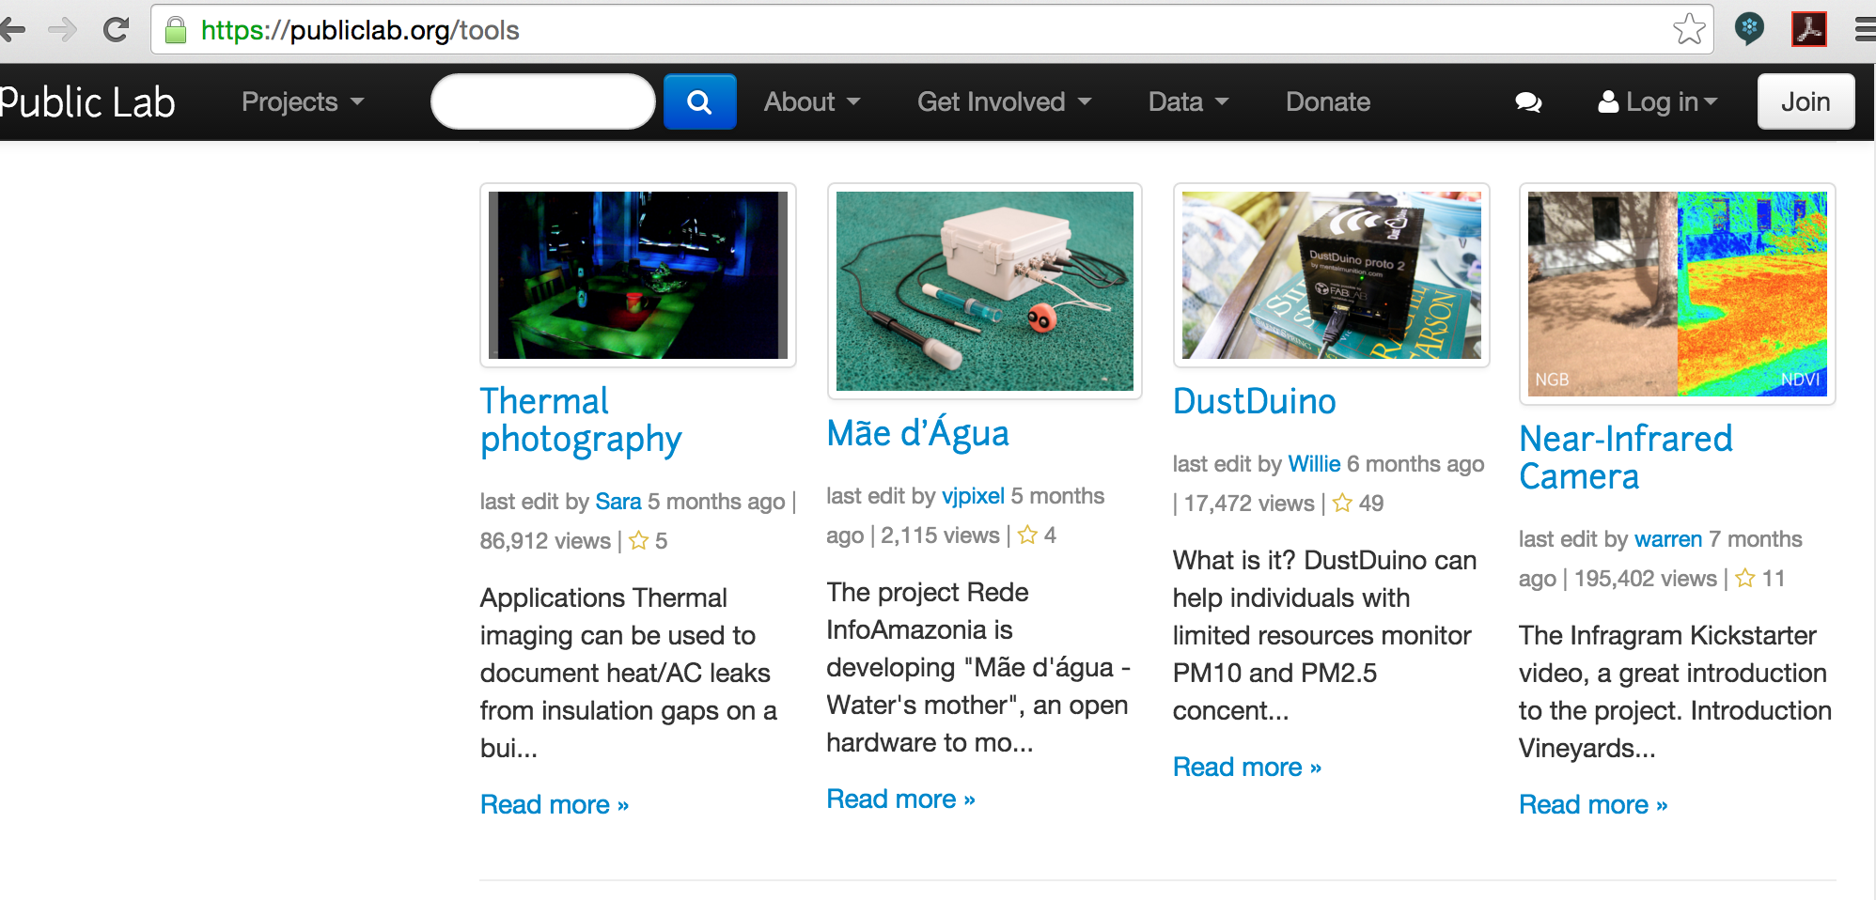
Creating your own data: Sensors
Notes:
You might also need to generate data for your problem by using sensors.

Slide 5
Be cynical about your data
Is the data relevant to your problem?
Where did this data come from?
Who collected it?
Why? What for?
Do they have biases that might show up in the data?
Are there holes in the data (demographic, geographical, political etc)?
Do you have supporting data? Is it *really* from a different source?
Can you use this data (are there privacy or copyright issues with using it)?
Notes:
Selection bias = non-random selection of individuals. One example of this is pothole reporting: potholes are more generally reported in more-affluent areas, by people who have both the smartphone apps and the time and energy to report.
Missing data = data that you don’t have. You need to be aware of this, and take account of it. If you need more persuading, read about Wald and the bullethole problem.

Slide 6
Data filetypes
Notes:
There are many datafile types - here’s a guide to some of them.

Slide 7
CSVs
Comma-separated values
Lots of commas
Sometimes tab-separated (TSVs)
Most applications read CSVs
Notes:
CSVs are the workhorse of datatypes: almost every data application can read them in.

Slide 8
Json
JavaScript Object Notation
Lots of braces { }
Structured, i.e. not always row-by-column
Many APIs output JSON
Not all applications read JSON
Notes:
Converting JSON to CSV:
Use a conversion website (e.g. http://www.convertcsv.com/json-to-csv.htm)
Write some Python code

Slide 9
XML
eXtensible Markup Language
Lots of brackets < >
Structured, i.e. not always row-by-column
Some applications read XML
HTML is a form of XML
Notes:
Converting XML to CSV:
Use a conversion website, e.g. http://www.convertcsv.com/xml-to-csv.htm
Write code

